Slide 1
Dinghy
Mattias, Niklas, David, Fredrik, Jesper, Alexander, Björn

Slide 2
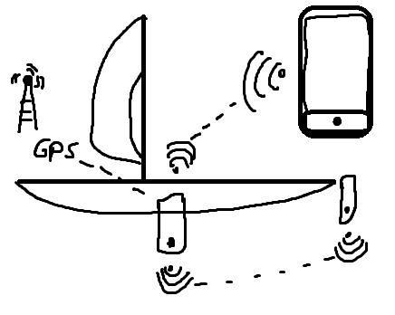
Vad ska vi göra?

Slide 3
Responsibility
Sensors
Fredrik
Position and Orientation
David
Component Communication
Jesper
Real-time feedback
Niklas
Application
Alexander
Logging and statistics
Mattias
Energy
Björn

Slide 4
Position and Orientation
Differential GPS for increased accuracy
IMU for inclination

Slide 5
Sensors
Pressure sensor for centerboard (and rudder)
Ultrasonic sensor for height of centerboard
waterproof solutions for mounting sensors

Slide 6
Components and Communication
Mainboard + sensor boards
Processor STM32F401 all boards
Bluetooth (RN42)
Notes:
Mainboard med IMU och höjdsensor, sensor boards med trycksensorer
Processor STM32F401 har funktionalitet som behövs samt det finns erfarenhet med utveckling på denna.RN42 bluetooth modul är vanlig och har funnits på marknaden ett tag så support dokumentation finns.
Dgps är oklart om hur man skall lösa denna.
Blueooth mellan alla boards samt smartphone

Slide 7
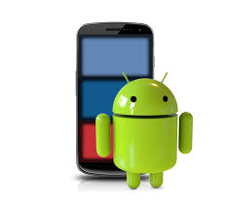
Application
Android application
Most phones and tablets use android
Easy development and testing
Boat status
Velocity
Position
Forces
Performance
Warnings
Feedback
Visible
Intuitive

Slide 8
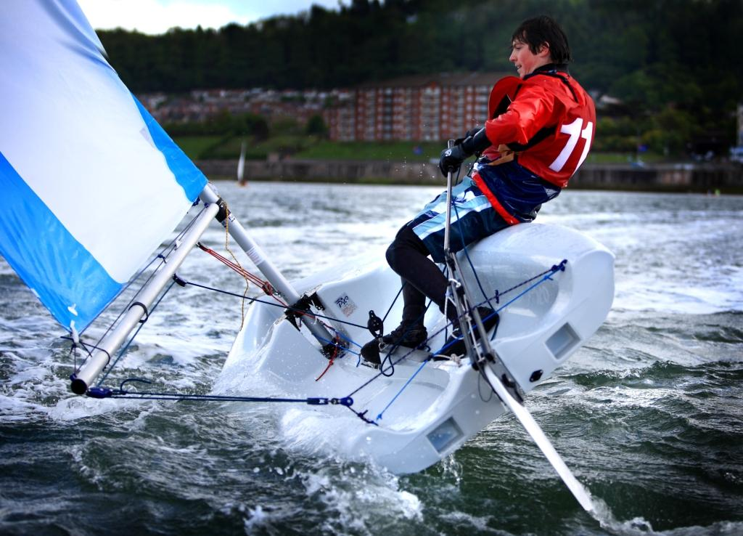
Real-time feedback
Interviews on what sort of feedback would be applicable
Physics of sailing
Interpretation of data from sensor
Produce applicable feedback
“Burka” (hiking)
Centerboard
Rudder
Haul sail
Bear off
Head up

Slide 9
Logging and statistics
Logging on smartphone
Statistic view in app
Transfer to pc

Slide 10
Energy
Deep-sleep mode
Power gating of components
Energy efficient components
Low polling rate
Battery size
Estimated battery life left
Power switches

